Slide 1

Protocol for strategic investment appraisal (SIA) on campus
Pls join the seminar on time - seminars are designed for you to share your knowledge and apply the concepts and techniques from the lecture and it will only work if you join in.
Come back with lots of questions. The more you ask, the more you will learn.

Slide 2
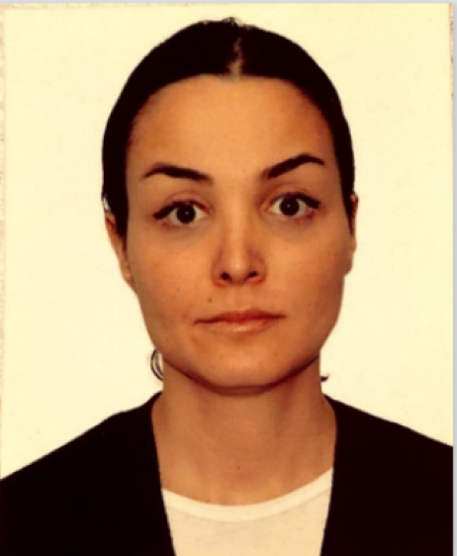
Welcome to strategic investment appraisal (SIA) seminar
Seminar tutor: Dr Ilayda Nemlioglu
Senior Lecturer in A&F
Office: QB206
Office Hours: Tuesday: 11:00-12:00 Wednesday 11:00-12:00 (please email for an appointment)
Email: ilayda.Nemlioglu@roehampton.ac.uk

Slide 3
Session plan
First half
Ice breakers
Lecture recap
Activity
Second half
Worksheet
Worksheet – check your answers
Summary and Q&A

Slide 4


Seminar Activity – ice breaker 1 Name: Ilayda Nemlioglu Background: short info about me

Slide 5
Seminar Activity – ice breaker 2 Pick one of these 2 Qs to share your hopes and fears for the module: Q1 What are you most looking forward to in this module and why? Q2 What do you feel less confident with in this module and why?

Slide 6
Lecture recap Week 1: Introduction to SIA in an international organisational context
1. What types of projects do international organisations invest in?
2. How do these relate to the business environment, industry sector, corporate strategy, value creation model and stakeholder expectations?
New product development (NPD)
Events e.g. theatre, sport, conferences
New site or relocation
Business acquisitions etc.
Context makes a huge difference (e.g. project characteristics, stakeholders)

Slide 7
Seminar Activity – Card game 1.1
Card game: It is the way to randomise some different case examples to discuss. Throughout the module, we call it card game.
The card will show the name of a well-known project (google it if it is unfamiliar)
Answer the following questions:
What organisation is responsible for it?
What is the business model (how do they create value for whom) of that organisation?
Who would be the key stakeholders in the project & what would they expect from it?
Where might the funding come from for it?

Slide 8

Card = 8 of clubs Scenario = Formula 1 Grand Prix (Singapore)
8
8

Slide 9
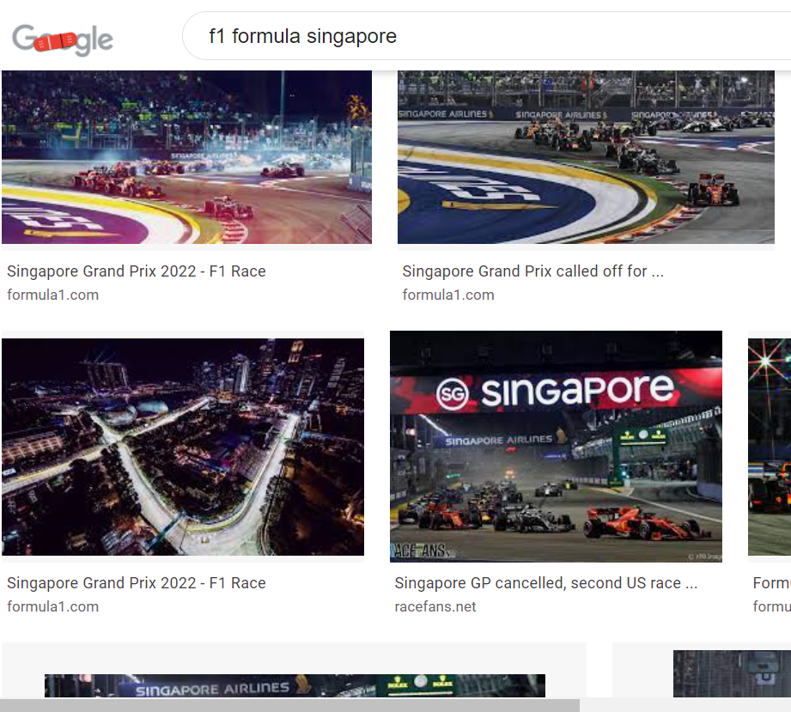
Card game 1.1: Formula 1 Grand Prix (Singapore)
Formula One Group
By running the most prestigious motor car event worldwide
Investors (profit), car manufactures (branding), developers (promote real estates around the circuit) etc.
Sponsors, motorsport fans etc.
What organisation is responsible for it?
What is the business model (how do they create value for whom) of that organisation?
Who would be the key stakeholders in the project & what would they expect from it?
Where might the funding come from for it?

Slide 10

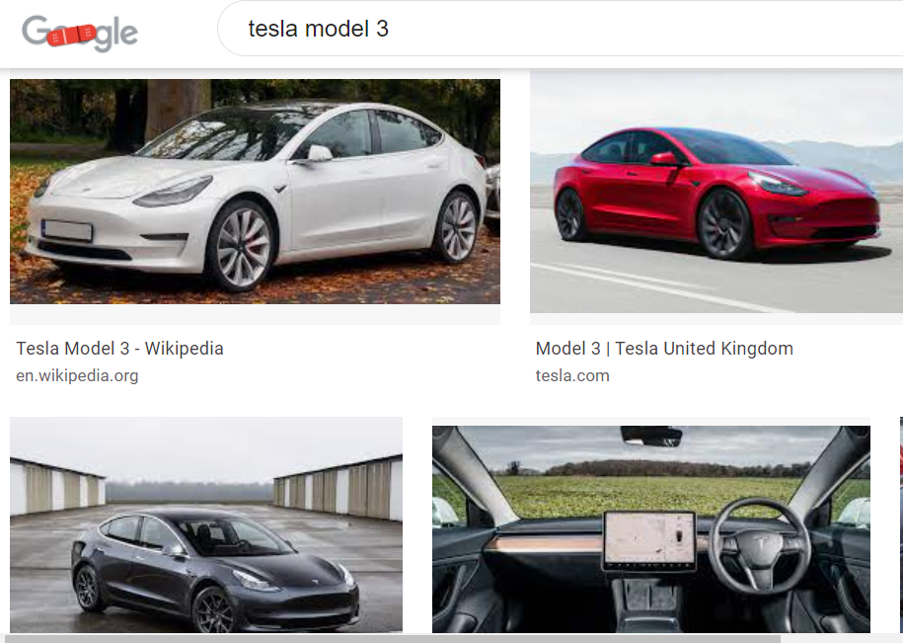
Card game 1.2 - Attempt this on your own after seminar 1 (to share your answers next week in seminar 2) Card = 5 of diamonds Scenario = Tesla Model 3 (new product - electric car)
5
5

Slide 11
Worksheet activity
Try filling ‘Answer’ and ‘Illustrate’ columns
Leave the last column (‘Find’) blank – You can do this column later for the assignment case study you tasked
Notes:
https://uk.advfn.com/stock-market/NYSE/GRUB/share-news/Grubhub-Reports-Second-Quarter-2020-Results/82960203

Slide 12
For the next seminar session
Prepare for the card game activity using Tesla Model 3 scenario
Q1. What organisation is responsible for it?
Q2. What is the business model (how do they create value for whom) of that organisation?
Q3. Who would be the key stakeholders in the project & what would they expect from it?
Q4. Where might the funding come from for it?
Keep and bring handouts you used in the worksheet activity to the next session -you can use them throughout in the seminars

Slide 13

Any questions? (on activities or the assessment brief)

